Slide 1
20190121
Lab meeting
Lee Jong Geon

Slide 2
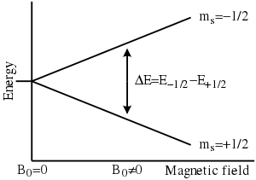
THz Electron Paramagnetic Resonance (EPR)
Zeeman effect

Slide 3
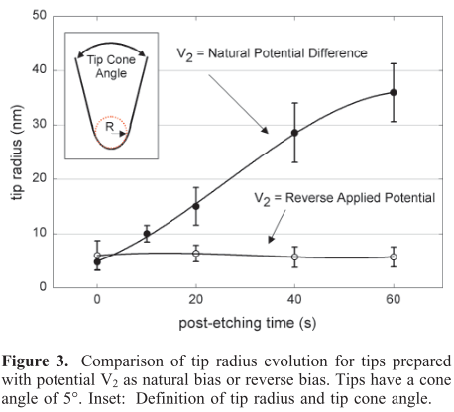
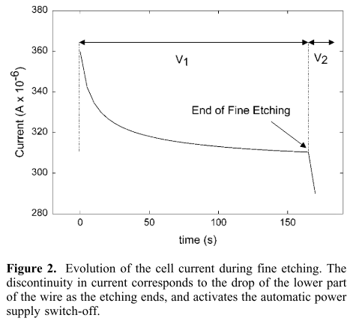
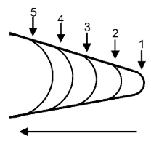
2011-Optics Express-19,25-Measurement of electron paramagnetic resonance using terahertz time-domain spectroscopy (Kohei Kozuki, Takeshi Nagashima, Masanori Hangyo)
Post-etching: wire가 끊어진 이후에도 etching process를 진행하는 것
Switch: 500 ns
Two step etching
Coarse etching: 2M KOH, DC 3V
post etching: 0.1M KOH, DC 0.5 V
An average of at least 5 tips.
“This method produces tips in a very controlled and reproducible manner.”

